Slide 1

Portfolio Project
P R E S E N T A T I O N
Adebayo Fahd
16 - Sep- 2022

Slide 2
Project Overview
About
ai.Wallet is a Fintech platform aimed at Managing, tracking and saving users monthly salary
Mission / Vision
To provide a very easy and highly secured platform for savings and other financial related.
To make savings very easy and fun.
About Us
Mission/Vision
Yewa is an online platform that renders essential service to clients especially during emergencies.
We render various services from the comfort of your homes varying from domestic to fashion and auto-mobile services.
Become essential to our clients by providing differentiated services to help them at any time.
To recruit trained unemployed people especially young adults.
To give small business owners the platform to showcase their services.

Slide 3
#2cace3
Colors:
#0171bc

Slide 4
C
O
S
T
O
F
P R O D U C T I O N
Capital: 250,00

Slide 5

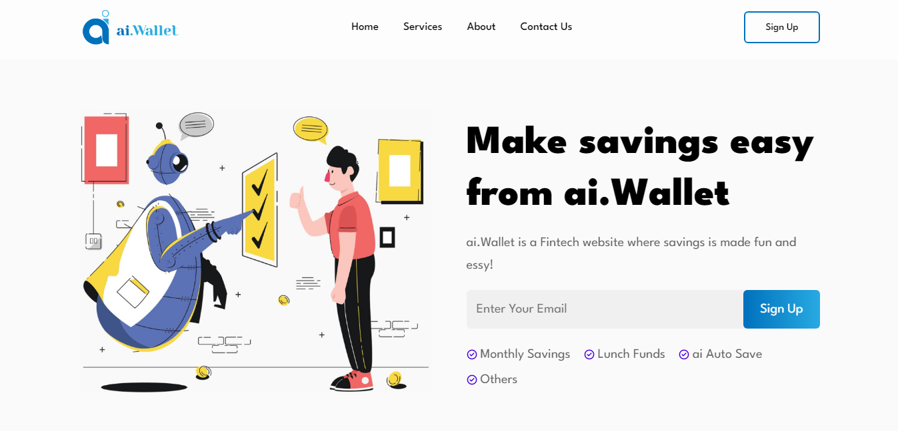
L
A
N
D
I
N
G
P
A
G
E

Slide 6
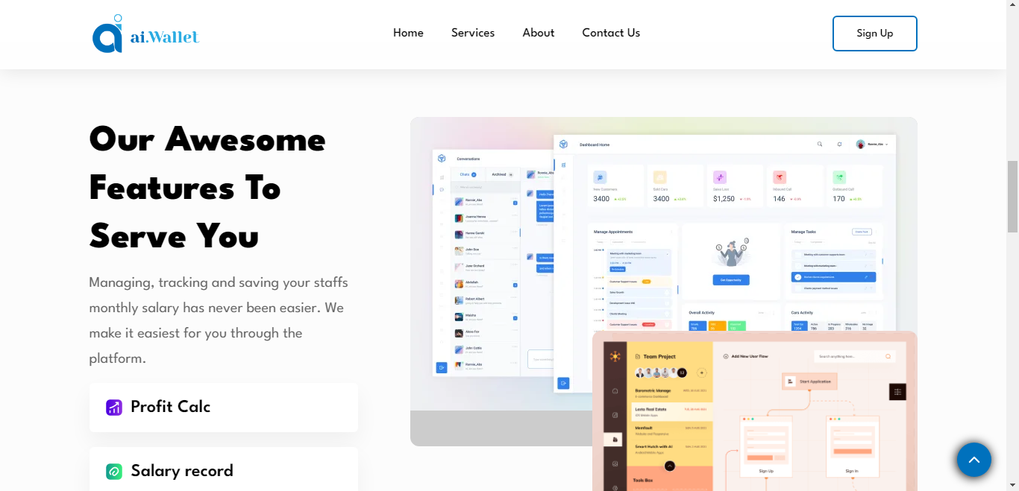
Thank
You

